Slide 1

VE496 Advanced Technical Communication
Week 9:
Technical Descriptions
Nathaniel T. Murray 莫子禅
Summer 2020

Slide 2
Organizing Technical Descriptions
Technical Definition, Purpose/Function, General Appearance, Components List
Parts and Components
Part 1
Component 1a
Component 1b
Part 2
Component 2a
Component 2b
Part 3
Component 3a
Component 3b
Functions and Uses
Function 1
Subfunction 1a
Subfunction 1b
Function 2
Subfunction 2a
Subfunction 2b
Function 3
Subfunction 3a
Subfunction 3b
Stages and Processes
Stage 1
Step 1a
Step 1b
Stage 2
Step 2a
Step 2b
Stage 3
Step 3a
Step 3b

Slide 3
Technical Descriptions: Linguistic Elements
Concrete, specific language
Breaking down into major and minor steps
Identify outcomes or “deliverables”
“The control input for this new brace design must be derived from naturally occurring movements of the leg. Pressure sensor will be used to monitor the forces exerted by the leg during extension or flexion movements. There will be two pressure sensors fixed to the knee brace: one will be at the upper end of the knee brace, the other will be at the lower end. A new program and function will be developed in MATLAB to automate the algorithm on a computer. Initial research suggests that MATLAB can be the programming tool for use for this project, due to its applicability to the engineering profession and its ease of use.” (from Sample Proposal with Methodology)

Slide 4
Technical Descriptions: Logic and Content
 | Physical Descriptions | Process Descriptions
Logic | Front to back (or vice-versa) Inside to outside (or vice-versa) Categorical: parts, components, subsystems | Order of events (active voice) Sequence of tasks (passive voice)
Content | Materials and textures Shape, colors, dimensions | Causes and effects Final outcomes or next steps Explanations for why phenomena occur
≠ Instructions
Active voice
No causal explanations

Slide 5
Technical Descriptions: Writing Guidelines
Describe similarities and/or differences
A micrometer caliper differs from other calipers in that it uses a calibrated screw instead of a slide to measure.
Use metaphors and analogies
Ransomware is like a thief that breaks into your house, changes the locks, then charges you money for entry.
Describe causes and effects
Magnetic fields are created by electric currents and magnetic moments of electric particles.
Describe the process in action
When hydrogen chloride (HCl) is dissolved into water, it forms two ions: H⁺ and Cl⁻.
Describe physical location
Feldspar makes up 41% of the Earth’s crust.
Use negation
An ion is not a subatomic particle.
Sources: Johnson-Sheehan (2015); Balzotti (2018)

Slide 6
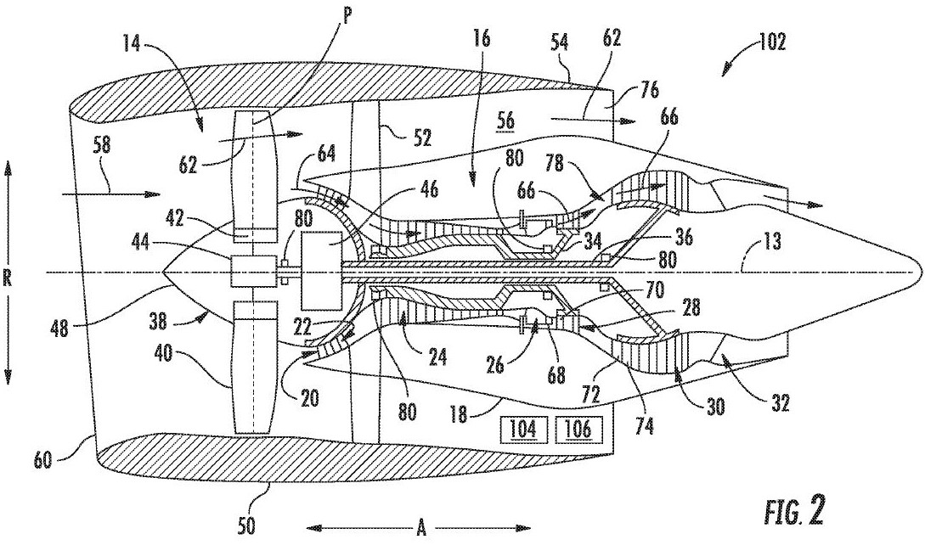
Technical Descriptions: Parts and Components
The exemplary core turbine engine 16 depicted generally includes a substantially tubular outer casing 18 that defines the annular inlet 20. The outer casing 18 encases and the core turbine engine 16 includes, in a serial flow relationship, a compressor section including a booster or low pressure (LP) compressor 22 and a high pressure (HP) compressor 24; a combustion section 26, a turbine section including a high pressure (HP) turbine 28 and a low pressure (LP) turbine 30; and a jet exhaust nozzle section 32.
Repetitive, systematic, and unambiguous
Source: United States Patent No. US010200110B2

Slide 7
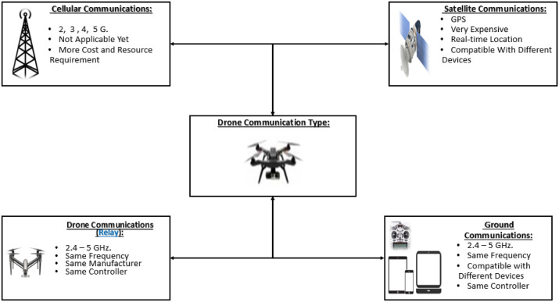
Technical Descriptions: Functions and Uses
2.3.3. Drone-To-Network
This communication type allows the choice of the network based on the required security level. It may also include cellular communications, which means relying on 3 GHz, 4 GHz, 4G+ (LTE) and 5 GHz. It is essential to secure such wireless communications networks when being used.
2.3.4. Drone-To-Satellite
This is the type of communication needed for sending real-time coordinates via the Global Positioning System (GPS). This allows any drone to be called back to its initial station in case it went beyond the line of control or outside the line of sight. Satellite communications are deemed secure and safe. However, they exhibit a high cost and maintenance requirements. This is why they are heavily used by armed forces.
Fig. 1. The different possible drone communication
Source: Yaacoub et al. (2020)

Slide 8
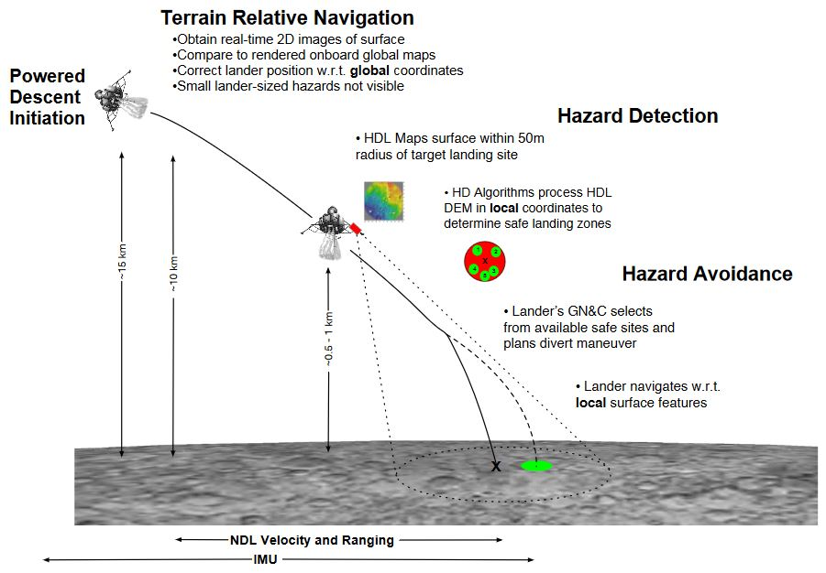
Technical Descriptions: Stages and Processes
As shown in Fig. 2, the HD Lidar will generate a DEM (digital elevation map) of the surface relative to the sensor head but expressed in surface-fixed coordinates provided by the lander’s navigation state. The HD algorithms will then characterize all the hazardous areas in the DEM and provide its host lander with options for safe landing sites. It is up to the lander’s guidance system to choose one of the provided safe landing sites and to navigate towards it. The high-resolution DEMs will be suitable for performing hazard relative navigation in the future, which is a TRN (Terrain Relative Navigation)-like function that utilizes the local maps to navigate.
Fig. 2 Precision Landing & Hazard Avoidance ConOps
Source: Restrepo et al. (2019)

Slide 9
Technical Descriptions: Typographic Elements
Paragraphs
Bullet points
Chapters and sections
Headings and subheadings
Numbering (of sections, paragraphs, and diagrams)
Pagination (by page number or section/sub-section)

